Slide 1
Econometrics
October 10th

Slide 2
Class Notes
Problem Set 2 – Answer key posted Wednesday
Thursday’s “Class”
Midterm Exam
Through Canvas
Open Thursday, complete by Friday night
3-hour window to complete, once you begin
Complete independently
Some multiple-choice/numeric answer, some open-ended
Not using gretl during exam, will be given output to interpret

Slide 3
Example
According to our discussion, standardized coefficients can by useful because:
(A) They eliminate outliers from the sample
(B) They allow us to compare the relative impact of variables measured in different units
(C) They convert negative coefficients to a positive equivalent
(D) They correct for the impact of multicollinearity in our results
(E) All of the above are reasons that standardized coefficients are useful

Slide 4
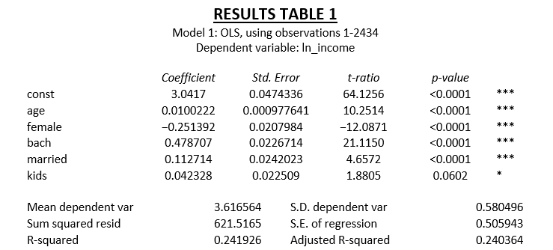
The regression results above utilize information from a 2019 American Community Survey of people living in Idaho. “kids” is a dummy variable equal to 1 if the individual has children living in the household. Interpret the coefficient and discuss whether the findings match your expectations.

Slide 5
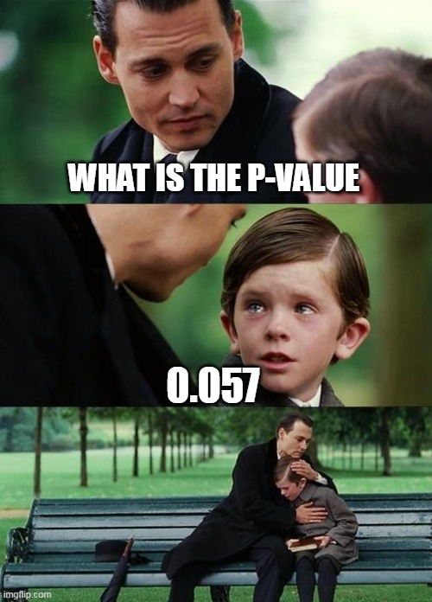
Review Topics
Regression Basics
Interpretations
Predictions
Residuals
Significance of coefficients
Explanatory power of models

Slide 6
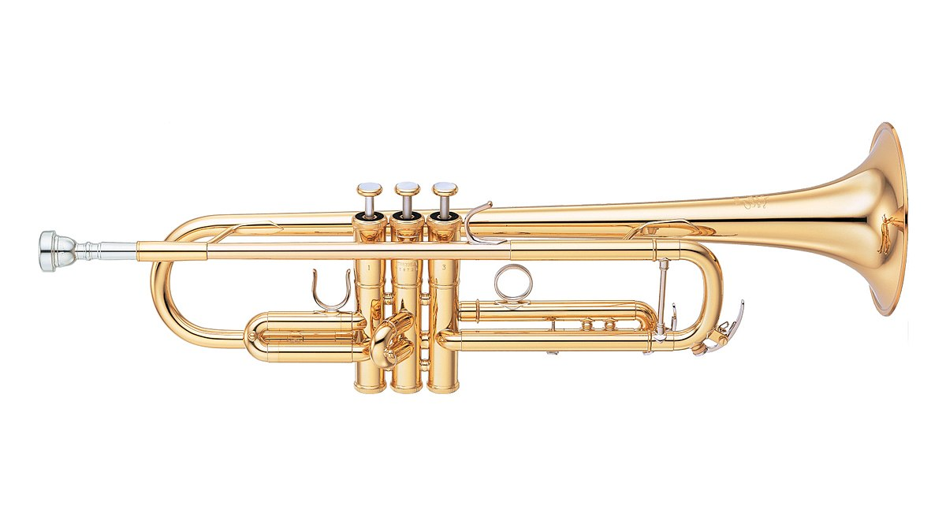
Review Topics
Testing Validity
Assumptions
Multicollinearity
Diagnosing
Corrections
Heteroskedasticity
Residual Plots
White’s Test
Correction

Slide 7
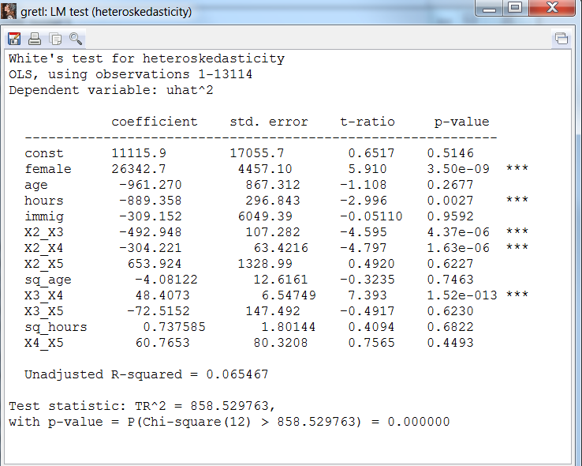
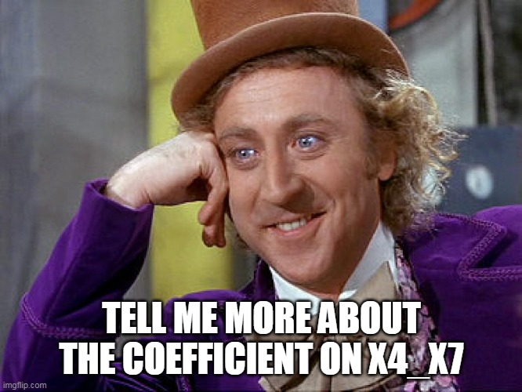
When we do the tests for heteroskedasticity (such as White’s test), we are generally not too concerned with the details. Overall, we just want to know how concerned we should be. In this case, the answer is very concerned.

Slide 8
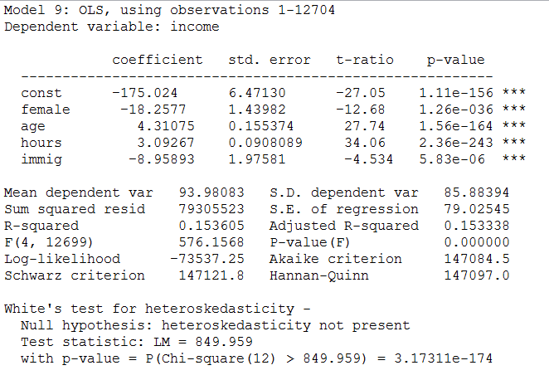


Slide 9



Review Topics
Modeling Options
Log Transformations
Quadratic Terms
Categorical Variables
Reference Category
Quantitative → Categorical?
Interaction Terms

Slide 10
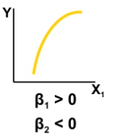
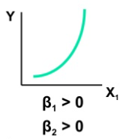
Remember that when we work with quadratic terms, we generally do not try to interpret the coefficients the same way (if x increases by 1,…). Instead, we focus on what the coefficients on the linear and squared term, as a group, tell us about the nature of the relationship.

Slide 11
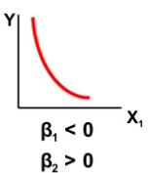
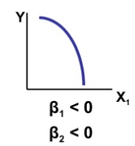

Slide 12
Review Topics
Other Stuff
Testing Coefficients
Standardizing Coefficients
Model Sensitivity

Slide 13


Slide 14
